Slide 1
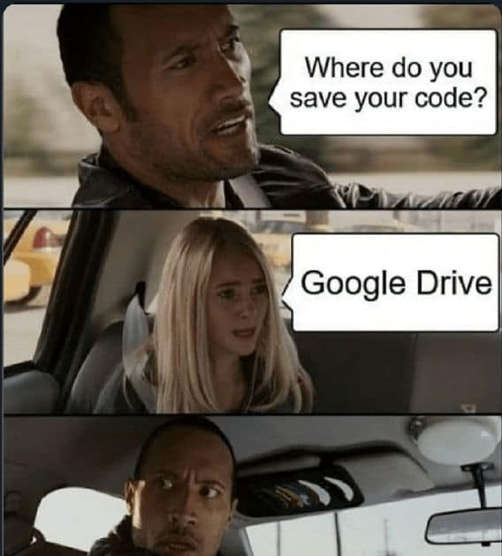


Bill, Camille, Jose
GitHub
Dropbox

Slide 2
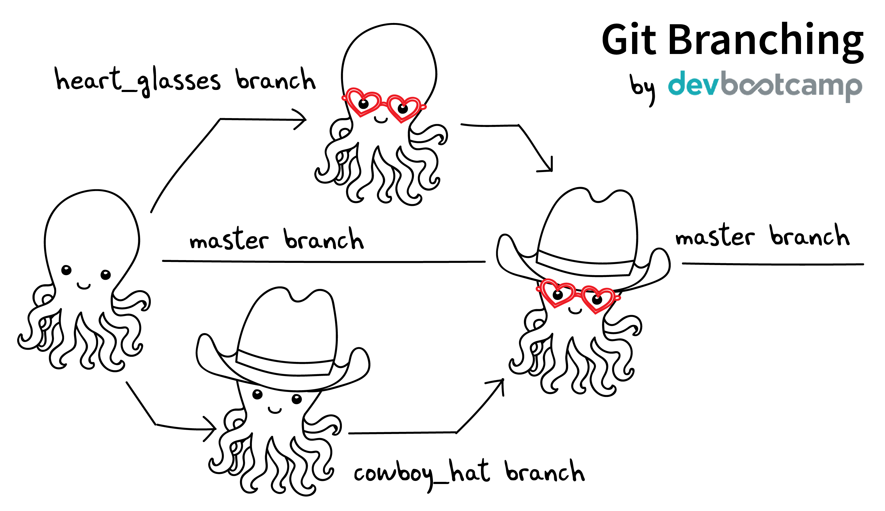
Our lesson today:

Slide 3
Assumptions today:
You have R Studio
You have R
You have GitHub Desktop
You have a GitHub account with access to Larry Walker Associates repos

Slide 4
Our lesson today
Clone Github Repo
Make a branch: Lets call it “feature-{YourNameHere}”
Make a new feature: Copy an example and edit it
Make a commit/pull to the new branch: This is like saving
Make a Pull Request (PR) on GitHub
Watch as it all comes together!

